Slide 1

Evaluation of the Effectiveness of NAMB’s Church Planter Pre-Assessment Process
Developing a ML classification model trained on the results of the pre-assessment survey to predict whether a couple is likely to be given the “ready” score based on the results of the pre-assessment survey.
By David Bello

Slide 2
Objectives
Determine predictive value of pre-assessment surveys
Name most significant questions in the survey
Build a ML model that predicts likelihood of endorsement based on survey results

Slide 3
I. Obtain data on:
CP Candidates (CPIA, 360)
Marriage assessment
Observers
No data from CP wives
Approach
II. Clean data and find best predictors
III. Build models to fit the data
IV. Draw conclusions

Slide 4
Data
275 Pre-assessment survey questions, 1,036 candidates between 2017 - 2022

Slide 5
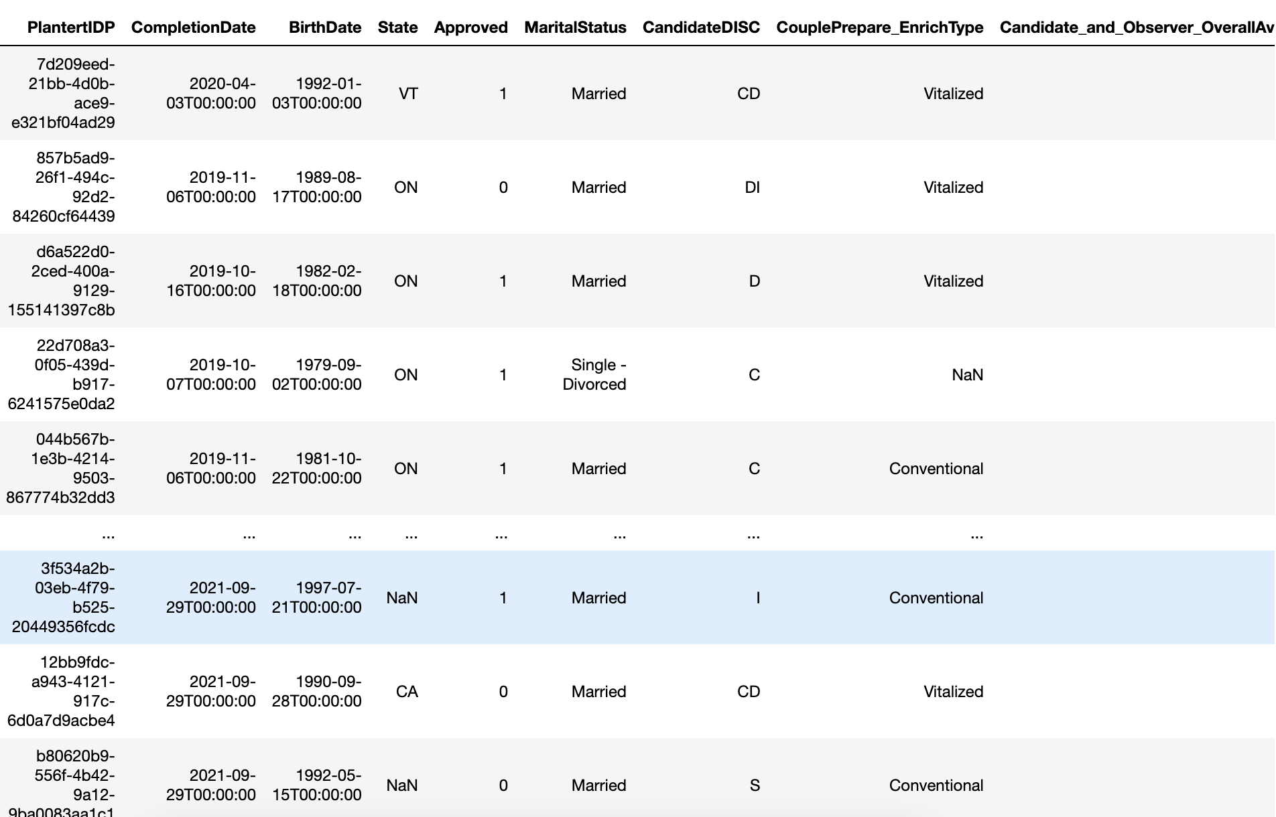
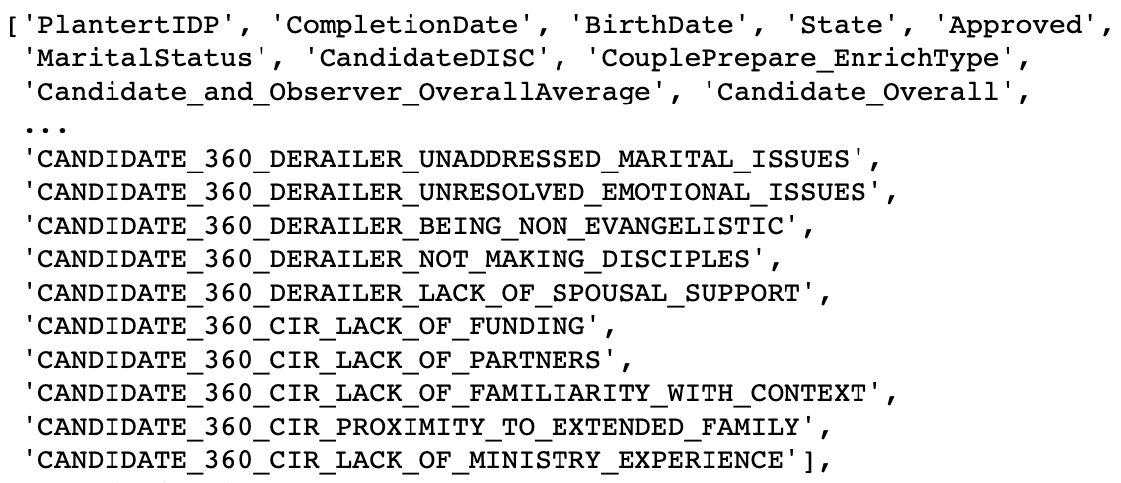

Slide 6
Data
Dataset 1
Dataset 2
Dataset 3

Slide 7

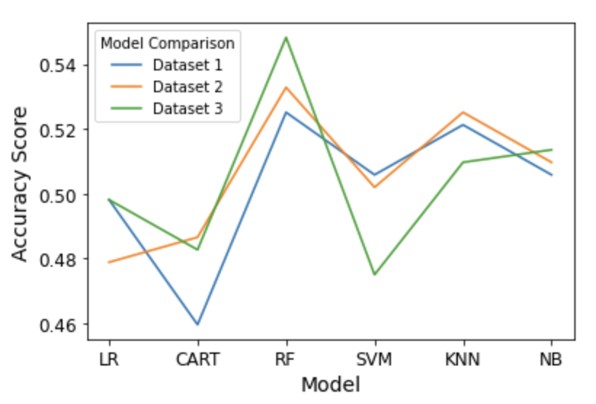
in
Data
out
Six Machine Learning Models

Slide 8
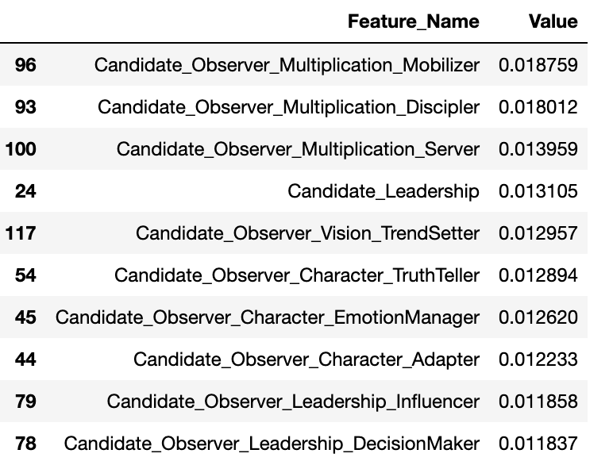
Important questions

Slide 9
Important questions

Slide 10
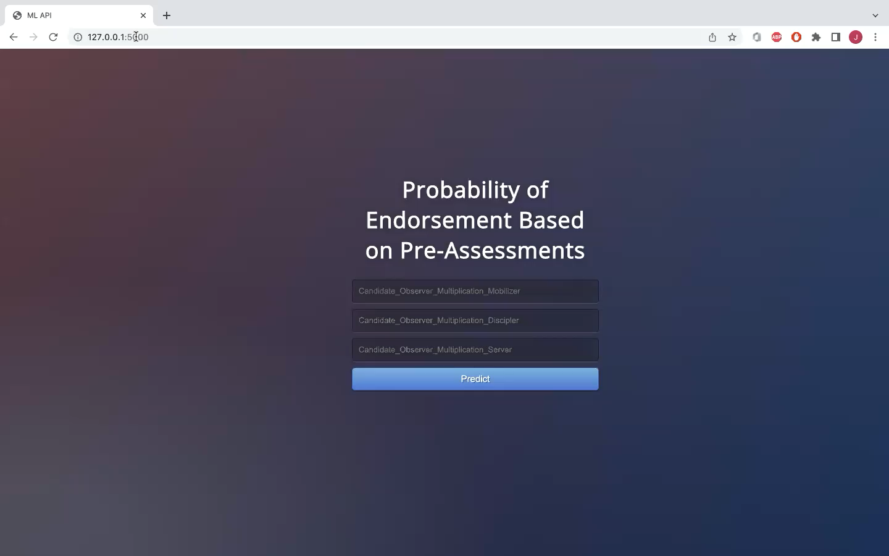

Slide 11
Conclusions
The pre-assessments are not a good predictor of approval for endorsement
Scores from the observers are highly correlated with approval
Possibly:
Decisions about approving a candidate are not relying on the surveys
Assessments hold no real value in their predicting capabilities
How valid is the opinion of the observers
Spouse data must be included
Missing data provides better predicting capabilities??

